Slide 1
Managing Information Technology Resources ITWS 4310
Data Analytics – Using Data
November 1, 2018

Slide 2
Managing IT Resources Class Outline: Thursday, Nov 1, 2018
Final Presentation Schedule
MITR Term Project
Schedule Meetings with Client and Invite Faculty to Meetings
Work on Design and Development
Draft of Entire Term Project Final Report on Nov 19 by 9 PM
Current Events
HBR Guide: Data - The Prerequisite for Everything Analytical
HBR Guide: What It Means to Put Analytics to Work

Slide 3
Randomly Assigned Final Presentation Schedule
Thursday Dec 6
Team 5
Team 2
Team 4
Monday Dec 10
Team 3
Team 1
Team 6
Invite your Clients to attend your class presentation and any or all of the other presentations on the two days.
In Addition, offer to present in a longer format (~ 1 hour) at the Client’s Location or on a Video Link to the Client’s Location.
If your Client cannot attend the day scheduled, but could on the other day, let us know and we will try to accommodate.
Presentations will be 15 minutes long with 5 minutes for Q&A. Time will be monitored and you will be given visual warnings at 3, 2, 1 minutes respectively.

Slide 4
Managing IT Resources: ITWS 4310 Term Project Report Outline
Section 1: Executive Summary
Section 2: Introduction
Section 3: Client Organization and Description
Section 4: Project Team
Section 5: Problem Statement
Section 6: IS/IT Solution
Section 7: Methodology
Section 8: IS/IT Requirements
Section 9: IS/IT Design
Section 10: Cost-Benefit Analysis with (Risk Mgmt)
Section 11: Project Plan/Schedule/Resources
Section 12: Post-Turnover Plan
Section 13: Results and Client Feedback
Section 14: Conclusions
All Sections of Final Report in Draft due by Nov 19 (Mon before Thanksgiving) at 9 PM

Slide 5
Managing IT Resources: ITWS 4310 Term Project Report Outline
Section 2: Introduction
Keep it short – 2-3 sentences
Only 2 objectives: provide a little context for the project and pique interest to read on
Section 3: Client Organization and Description
Give some idea of the size of the organization: number of employees, number of locations, etc.
Include Client Contact name and contact information
Section 6: IS/IT Solution
If solution has changed throughout semester, make reference to the original solution concept and then describe current/latest solution concept
Section 7: Methodology
Brief description of how each major aspect of project was done e.g. a cost benefit analysis focused on NPV and IRR was used to assess financial viability of the project. Don’t’ be repetitive with subject section
Cover project/client selection, requirements, development methodology, financial viability, project management, implementation methodology, and client feedback method

Slide 6
Managing IT Resources: ITWS 4310 Term Project Report Outline
Section 1: Executive Summary
Should be able to “stand on its own”
Provides an “executive” overview of the entire project
What are the important points that an executive would need to know?
The best summaries effectively balance details with a concise writing style

Slide 7
Managing IT Resources: ITWS 4310 Term Project Report Outline
Section 8: IS/IT Requirements
Categorize both Functional and Non-Functional Requirements
Section 9: IS/IT Design and Development
Use-Case Summary (part of narrative) and Use-Case Diagram
Work Flow Diagram (logic that connect back-end with front-end)
Back-end Design including Data Work Flow and Database Design
Front-end Design including Mock-ups, Wireframes, Screen Shots
Working System including link to working system or prototype
Access to Code in Code Repository
Test Plan(s) and Test Results
Narrative of All Design and Development
Section 10: Cost Benefit Analysis with Risk Management
Combine the Excel Sheets for CBA and Risk Management into one Excel Workbook
Combine the CBA and Risk Management into one Narrative

Slide 8
Managing IT Resources: ITWS 4310 Term Project Report Outline
Section 11: Project Management/Resource/Schedule
Specify reference to separate Gantter project plan
Include screenshot showing entire project in report
Summary of major project phases including the duration, work effort, costs for each phase. Can be organized into a summary table
Section 12: Post-Turnover Plan
Installation
Training
Documentation
Future support and maintenance plan

Slide 9
Managing IT Resources: ITWS 4310 Term Project Report Outline
Section 13: Results and Client Feedback
Specify what functionality was delivered when
Results showing that the System meets the “Requirements” or not
Client Feedback
Section 14: Conclusions
What were the “lessons learned” by the team
What worked well
What didn’t work well
What would you do differently “next time”
Cover team dynamics, client dynamics, and technology

Slide 10
Quiz!
4 questions, 1 fill-in chart
10 minutes

Slide 11
Technology Current Events: “GE slashes 119-year old dividend to a penny”, CNN, October 30, 2018. https://www.cnn.com/2018/10/30/investing/ge-dividend-cut-earnings-culp/index.html
General Electric is under such financial stress that new CEO Larry Culp is slashing the troubled conglomerate's 119-year-old dividend to just a penny a share.
GE revealed on Tuesday worse-than-expected results and a $22 billion accounting writedown for its beleaguered power division. Culp plans to split up the power division to accelerate a turnaround.
The company also announced that the SEC and Justice Department are investigating the charge, which reflects the deterioration of businesses GE has acquired. The news adds to GE's mounting legal problems and helped send the stock plunging 9% to a nine-year low. It was GE's worst day since March 2009.
In a bid to fix GE's debt-riddled balance sheet, Culp announced the company will cut its quarterly dividend from 12 cents a share starting in 2019. By paying just a token dividend, GE (GE) will save about $3.9 billion of cash per year. Analysts had been anticipating a potential dividend cut, though not one of this magnitude.
It's an especially painful move for a company that long viewed its stable dividend as a source of pride. But years of bad decisions forced GE to halve its dividend last November for just the second time since the Great Depression.
Investors may have been spooked by the fact that GE did not even offer guidance for the fourth quarter or 2019. "There was no reset. They didn't even tell you what the earnings and cash flow will look like. They just don't know," said John Inch, an analyst at Gordon Haskett.

Slide 12
Technology Current Events: “Walmart's clever plan to keep checkout lines moving during the holiday season”, Yahoo Finance, October 30, 2018. https://finance.yahoo.com/news/walmarts-clever-plan-keep-checkout-lines-short-holiday-season-105558184.html
New in stores starting November 1 will be the “Check Out With Me” service, where associates will be positioned with handheld devices in some of the heaviest trafficked areas of the store, like the garden center or electronics department, allowing customers to purchase items in that department so they can bypass long lines at the register. “The idea is we are not going to be checking out large baskets standing in the aisles doing it. It’s geared toward one or two items, said Steve Bratspies, the chief merchandising officer for Walmart U.S. “It can be any items. There’s no level set on [the] price.”
Another new offering will be digital store maps for each of the 4,700 locations on the Walmart app to help customers quickly locate a product “down to the exact aisle location.” “There’s no more searching through dozens of aisles to find out what’s on your list,” added Bratspies.
Walmart has already announced plans to broaden its selection of holiday gifts, ranging from Bose to KitchenAid to Fornite and Ryan’s World toys. Following the fall of Toys ‘R’ Us, Walmart doubled-down on its toy offering, adding 30% more toys in stores and increasing its online offering by 40%. The retailer recently shared its list of top 40 toys curated by “toy influencers” and “every-day kids.”
As free two-day shipping becomes the expectation in retail, Walmart will start offering shoppers free, two-day shipping on orders over $35 for “millions of items” from third-party marketplace sellers without a membership fee. Two years ago, Walmart began offering free two-day shipping for items it directly sells on its website. In addition to the free two-day shipping offering, Walmart is also offering customers the ability to make any returns on marketplace items at its 4,700 store locations.
“Our approach on how we price and how we go to market isn’t really changing, which is we are going to be the low price leader in the market. And we never want to take prices up, and will always work to avoid doing that wherever we can. And it’s a balance,” said Bratspies in response to a Yahoo Finance question.

Slide 13
Technology Current Events: “Mark Zuckerberg Says Apple's iMessage is Facebook's 'Biggest Competitor by Far’”, MacRumors, October 31, 2018. https://www.macrumors.com/2018/10/31/mark-zuckerberg-says-imessage/
Facebook CEO Mark Zuckerberg on Tuesday singled out Apple's iMessage mobile messaging service as Facebook's "biggest competitor by far." (via CNBC). The comments were made to investors during an earnings call for the company's third quarter performance, in which the Facebook CEO admitted the social platform was losing out to iMessage in "important" territories like the U.S., where iPhone sales are highest. "Our biggest competitor by far is iMessage," Facebook CEO Mark Zuckerberg said in an earnings call on Tuesday with investors, referring to the messaging service built into the iPhone and other Apple products. "In important countries like the U.S. where the iPhone is strong, Apple bundles iMessage as a default texting app and it's still ahead," he said. The Facebook chief said the company had identified a shift in the way users are communicating, with many transitioning from publicly shared content to private messaging, thanks to services like Messenger, WhatsApp, and Apple's iMessage.
Zuckerberg also responded to vehement criticism from Apple CEO Tim Cook about companies that use people's personal information as a business model for profit. "It's worth noting that one of the main reasons people prefer our services, especially WhatsApp, is because of its stronger record on privacy," Zuckerberg said. "WhatsApp is completely end-to-end encrypted, does not store your messages, and doesn't store the keys to your messages in China or anywhere else. And this is important because if our systems can't see your messages, then that means that governments and bad actors won't be able to access them through us either.” Zuckerberg's reference to China is likely a dig at Apple, which recently transferred its China iCloud services from a hosting location in the United States to servers owned and operated by a state-run Chinese company.

Slide 14
HBR Guide: Data Analytics Basics for Managers
Getting Started
Are You Data-Driven
Know Your Goal
Gather the Right Information
Do You Need All That Data?
How to Ask Your Data Scientists for Data and Analytics
How to Design a Business Experiment
Know the Difference Between Your Data and Your Metrics
The Secret to Better Netflix Recommendations and Better Decision Making
Can Your Data Be Trusted

Slide 15
HBR Guide: Data Analytics Basics for Managers
Analyze the Data
Two Ways to Keep You Data from Tricking You
A Predictive Analytics Primer
Understanding Regression Analysis
When to Act on Correlation, and When Not To
A Refresher on Statistical Significance
Communicate Your Findings
Data is Worthless If You Don’t Communicate It
What IBM Teaches Us About Sharing Data Findings
When Data Visualization Works – and When It Doesn’t
How to Make Visuals That Pop and Persuade
Decisions Don’t Start with Data

Slide 16
HBR Guide: Data Analytics Basics for Managers
Getting Started
Are You Data-Driven
Traits of Data Driven
Make decisions at the lowest possible level
Bring as much diverse data to any situation as they possibly can
Use data to develop a deeper understanding of their worlds
Develop an appreciation for variation
Deal reasonably well with uncertainty
Integrate their ability to understand data and its implications with their intuitions
Recognize the importance of high-quality data and invest to make improvements
Conduct good experiments and research
Recognize that decision criteria can vary with circumstances
Realize that making a decision is only the first step
Work hard to learn new skills and bring new data and new data technologies (big data, predictive analytics, metadata management, etc.) into their organization
Learn from their mistakes

Slide 17
HBR Guide: Data Analytics Basics for Managers
Getting Started
Know Your Goal
Analytics Based Decision Making in Six Key Steps
Recognize the problem or question
Review previous findings
Model the solution and select the variables
Collect the data
Analyze the data
Present and act on the results
Ask lots of questions along the way
Establish a culture of inquiry, not advocacy

Slide 18
HBR Guide: Data Analytics Basics for Managers
Gather the Right Information
Do You Need All That Data?
Are we asking the right questions?
Does our data tell a story?
Does our data help us look ahead rather than behind?
Do we have a good mix of quantitative and qualitative data?

Slide 19
HBR Guide: Data Analytics Basics for Managers
Gather the Right Information
How to Ask Your Data Scientists for Data and Analytics
What Questions Should We Ask?
What Data Do We Need?
How Do We Obtain the Data?
Is the Data Clean and Easy to Analyze?
Understanding the Cost of Data
Is the Model Too Complicated?

Slide 20
HBR Guide: Data Analytics Basics for Managers
Gather the Right Information
How to Design a Business Experiment
Identify the Narrow Question
Use a Big Hammer
Perform a Data Audit
Select a Study Population
Randomize
Commit to a Plan, and Stick to it
Let the Data Speak

Slide 21
HBR Guide: Data Analytics Basics for Managers
Gather the Right Information
Know the Difference Between Your Data and Your Metrics
You Can’t Pick Your Data, but You Must Pick Your Metrics
Organizations Become Their Metrics
Metrics Are only Valuable if You Can Manage to Them

Slide 22
HBR Guide: Data Analytics Basics for Managers
Gather the Right Information
The Secret to Better Netflix Recommendations and Better Decision Making
Can Your Data Be Trusted
Evaluate Where It Came From
Assess Data Quality Independently
Clean the Data
Ensure High-Quality Data Integration

Slide 23
HBR Guide: Data Analytics Basics for Managers
Analyze the Data
Two Ways to Keep You Data from Tricking You
Human beings are experts at motivated reasoning.
Mechanisms of motivated reasoning kick in unconsciously from the moment we look at data.
As a result, there is a tendency to see what we expect to see.
In order to counteract motivated reasoning, it is crucial to start treating data the way scientists do.
The scientific method starts by making predictions about what you would expect to observe if a particular belief about the world is correct. If that prediction is inconsistent with the data, then you have to revise your understanding of the world.
A second reason why it is important to make predictions about what you expect to see first, before looking at the data, is that patterns of data are often quite subtle. Often, we imagine that there is some big obvious pattern.
Instead, most of the key insights in data involve interactions.

Slide 24
HBR Guide: Data Analytics Basics for Managers
Analyze the Data
A Predictive Analytics Primer
The Data – need good data
The Statistics – regression analysis is the primary tool
The Assumptions critical
Can you tell me something about the source of the data you used in your analysis
Are you sure the sample data is representative of the population
Are there any outliers in you data-distribution? How do they affect the results?
What assumptions are behind your analysis?
Are there any conditions that would make your assumptions invalid?

Slide 25
HBR Guide: Data Analytics Basics for Managers
Analyze the Data
Understanding Regression Analysis
What is regression analysis?
How does it Work?
How do companies use it?
Correlation is Not Causation
What Mistakes Do People Make When Working with Regression Analysis
Don’t tell you data analyst to go figure out what is affecting sales.
Identify the factors that you suspect are having an impact
Can you effect the independent variable being investigated
Don’t let data replace intuition
Beware of Spurious Correlations

Slide 26
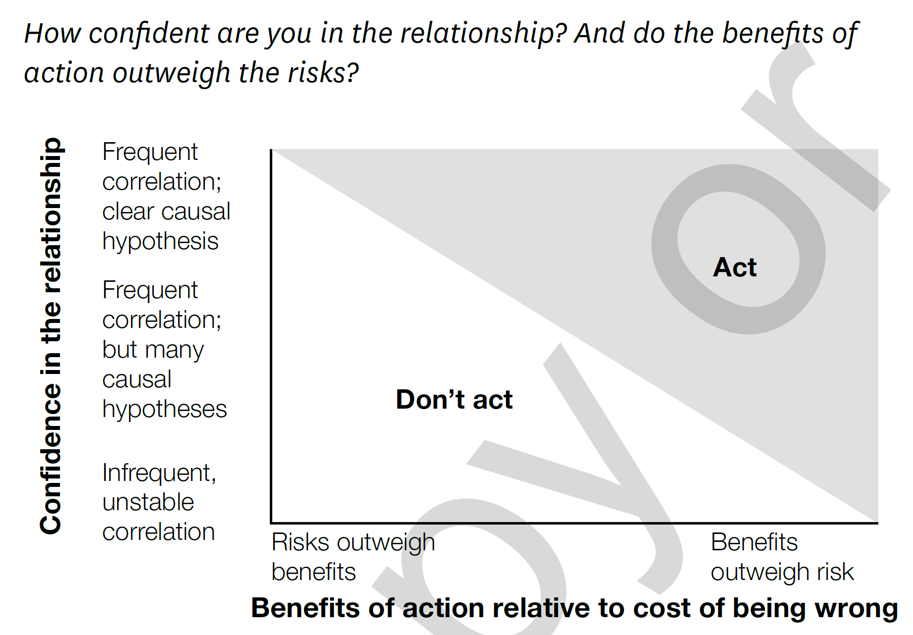
HBR Guide: Data Analytics Basics for Managers
Analyze the Data
When to Act on Correlation, and When Not To
Can I take action on the basis of the correlation finding? It depends on two factors:
Confidence that correlation will reliably recur in the future.
The trade-off between the risk and reward of acting.

Slide 27
HBR Guide: Data Analytics Basics for Managers
Analyze the Data
A Refresher on Statistical Significance
Statistical Significance helps quantify whether a result is likely due to chance or to some factor of interest. When a finding is significant, it simply means you can feel confident that that it’s real, not that you just got lucky.
Population Variation is important
Non-sampling error involves things where the experimental and measurement protocols didn’t happen according to plan.
Statistic (not to be confused with Statistics)
Characteristic or measure obtained from a sample.
Statistics
Collection of methods for planning experiments, obtaining data, and then organizing, summarizing, presenting, analyzing, interpreting, and drawing conclusions.

Slide 28
Populations and samples
A population = “all” of the data, if you can get it (BIG Data)
This is what is different about the methods you use
A sample = “some” of the data, and you may not know how representative it is
This is what limits analysis but certainly the development of models
Courtesy Marshall Ma (and prior sources)
28
Notes:
Courtesy Marshall Ma (and prior sources)

Slide 29
HBR Guide: Data Analytics Basics for Managers
Communicate Your Findings
Data is Worthless If You Don’t Communicate It
Framework for communicating about each analysis:
My understanding of the business problem
How I will measure the business impact
What data is available
The initial solution hypothesis
The solution
The business impact of the solution

Slide 30
HBR Guide: Data Analytics Basics for Managers
Communicate Your Findings
What IBM Teaches Us About Sharing Data Findings
Have Something Important to Say
Organize Your Thoughts
Use Your Data Points Carefully
Tell Stories
Write Sparingly and Well

Slide 31
HBR Guide: Data Analytics Basics for Managers
Communicate Your Findings
When Data Visualization Works – and When It Doesn’t
Three broad reasons for visualizing data
Confirmation
Education
Exploration
Our ability to understand and control three areas of risk can define the visualization’s resulting value
Data Quality
Context
Biases

Slide 32
HBR Guide: Data Analytics Basics for Managers
Communicate Your Findings
How to Make Visuals That Pop and Persuade
Am I Presenting or Circulating My Data?
Am I Using the Right Kind of Chart of Table?
What Message Am I Trying to Convey?
Do My Visuals Accurately Reflect the Numbers?
Is My Data Memorable?

Slide 33
HBR Guide: Data Analytics Basics for Managers
Communicate Your Findings
Decisions Don’t Start with Data

Slide 34
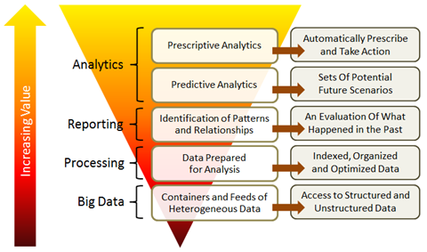
The nature of the challenge

Slide 35
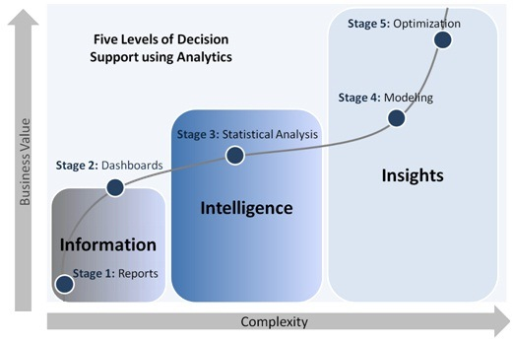
Notes:
http://www.defiance-tech.com/sites/default/files/services_solutions/Enterprise_Analytics_Service_4.jpg

Slide 36
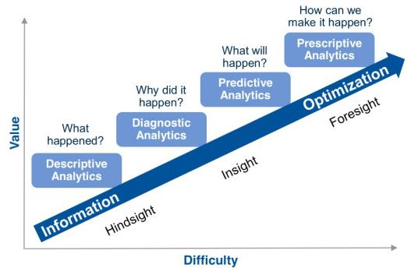

Slide 37
HBR Guide: Data Analytics Basics for Managers
HBR Analytics Overview
https://www.youtube.com/watch?v=jUFPFtU-564
Analytics In Use
https://www.youtube.com/watch?v=J11FMQLkYfM
IBM
https://www.youtube.com/watch?v=V2xuSuNDj0E
Zara
https://www.youtube.com/watch?v=bkcAmCqIaao
DHL
https://www.youtube.com/watch?v=00wOf3xEQD4
BMW
https://www.youtube.com/watch?v=SUIcf2U6pu4
Moneyball
https://www.youtube.com/watch?v=CkY6RA4hOfo
Notes:
HBR: https://www.youtube.com/watch?v=jUFPFtU-564
https://www.youtube.com/watch?v=J11FMQLkYfM
IBM: https://www.youtube.com/watch?v=V2xuSuNDj0E
ZARA: https://www.youtube.com/watch?v=bkcAmCqIaao
DHL: https://www.youtube.com/watch?v=00wOf3xEQD4
BMW: https://www.youtube.com/watch?v=SUIcf2U6pu4
Moneyball: https://www.youtube.com/watch?v=CkY6RA4hOfo

